Slide 1
Institute Vision & Mission
Institute Vision
Evolve into an academy of excellence to serve the knowledge society.
Institute Mission
Inculcate technical innovations, creativity, team spirit, entrepreneurial leadership and high standards of professional ethics

Slide 2
Department : Computer Science & Engineering
Department VISION:
Evolve into an academy of excellence to serve the emerging knowledge based society.
Department MISSION:
Provide quality education to the graduate and undergraduate students in Computer Science and Engineering that equip them with technical knowledge and values for employment in industry and to empower them to succeed in innovative research and developments so as to serve the computational and allied requirements of the society.

Slide 3
PROGRAM EDUCATIONAL OBJECTIVES (PEO)
Computer Science & Engineering
1.Graduates with their solid foundation in Computer Science & Engineering and broad knowledge in mathematics, science, and basic engineering shall be competent for higher studies or to pursue a profession in computing.
2.Graduates shall have an educational foundation that enables them to be good entrepreneurs and be adaptive to the advancements in the latest technologies.
3.Graduates shall exhibit the ability to function in multi-disciplinary teams, ethically and responsibly, contributing to the information technology requirements of the society.

Slide 4
Engineering Graduates will be able to:
PO1. Engineering knowledge: Apply the knowledge of mathematics, science, engineering fundamentals, and an engineering specialization to the solution of complex engineering problems.
PO2. Problem analysis: Identify, formulate, review research literature, and analyze complex engineering problems reaching substantiated conclusions using first principles of mathematics, natural sciences, and engineering sciences.
PO3. Design/development of solutions: Design solutions for complex engineering problems and design system components or processes that meet the specified needs with appropriate consideration for the public health and safety, and the cultural, societal, and environmental considerations.
PO4. Conduct investigations of complex problems: Use research-based knowledge and research methods including design of experiments, analysis and interpretation of data, and synthesis of the information to provide valid conclusions.
PO5. Modern tool usage: Create, select, and apply appropriate techniques, resources, and modern engineering and IT tools including prediction and modeling to complex engineering activities with an understanding of the limitations.
PO6. The engineer and society: Apply reasoning informed by the contextual knowledge to assess societal, health, safety, legal and cultural issues and the consequent responsibilities relevant to the professional engineering practice.
PO7. Environment and sustainability: Understand the impact of the professional engineering solutions in societal and environmental contexts, and demonstrate the knowledge of, and need for sustainable development.
PO8. Ethics: Apply ethical principles and commit to professional ethics and responsibilities and norms of the engineering practice.
PO9. Individual and team work: Function effectively as an individual, and as a member or leader in diverse teams, and in multidisciplinary settings.
PO10. Communication: Communicate effectively on complex engineering activities with the engineering community and with society at large, such as, being able to comprehend and write effective reports and design documentation, make effective presentations, and give and receive clear instructions.
PO11. Project management and finance: Demonstrate knowledge and understanding of the engineering and management principles and apply these to one’s own work, as a member and leader in a team, to manage projects and in multidisciplinary environments.
PO12. Life-long learning: Recognize the need for, and have the preparation and ability to engage in independent and life-long learning in the broadest context of technological change.

Slide 5
PROGRAM SPECIFIC OUTCOME (PSO) of B.Tech Computer Science & Engineering
1) An ability to analyse, design, and develop system software, secure application software, intellegent systems, computer architecture, and network based computing solutions.
2) An ability to analyse & design algorithms, and implement the solutions incorporating various programming concepts.
3) An ability to apply different software project development approaches to tackle real life problems.

Slide 6
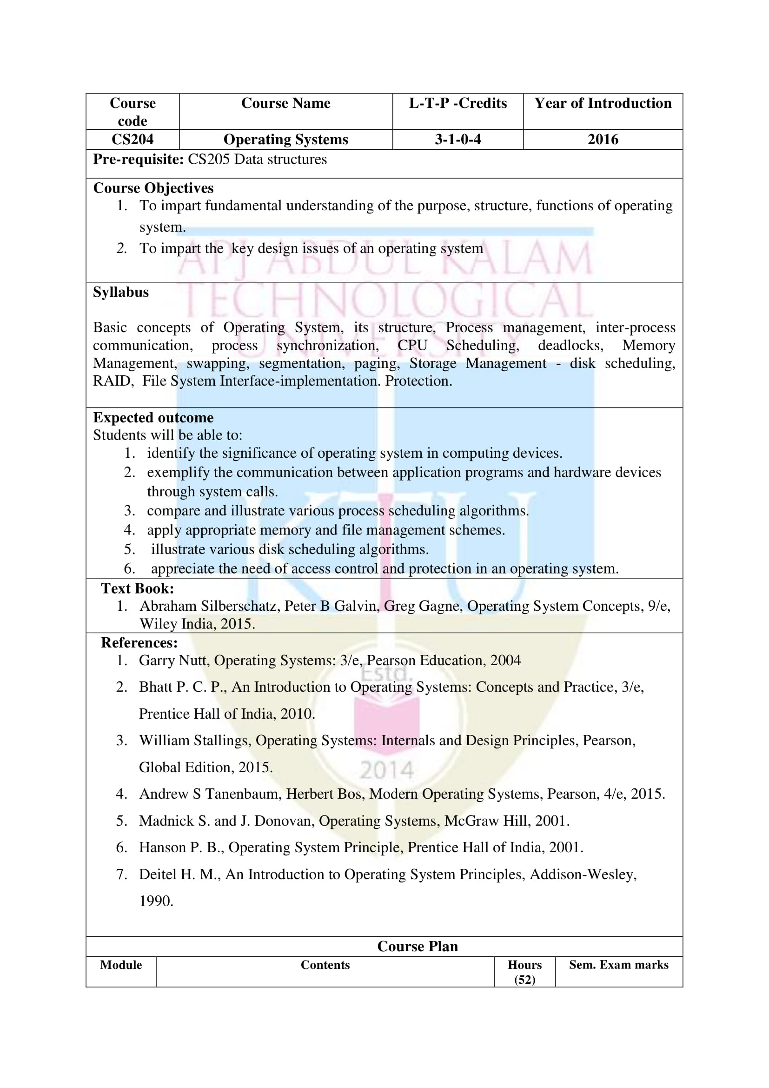

Slide 7
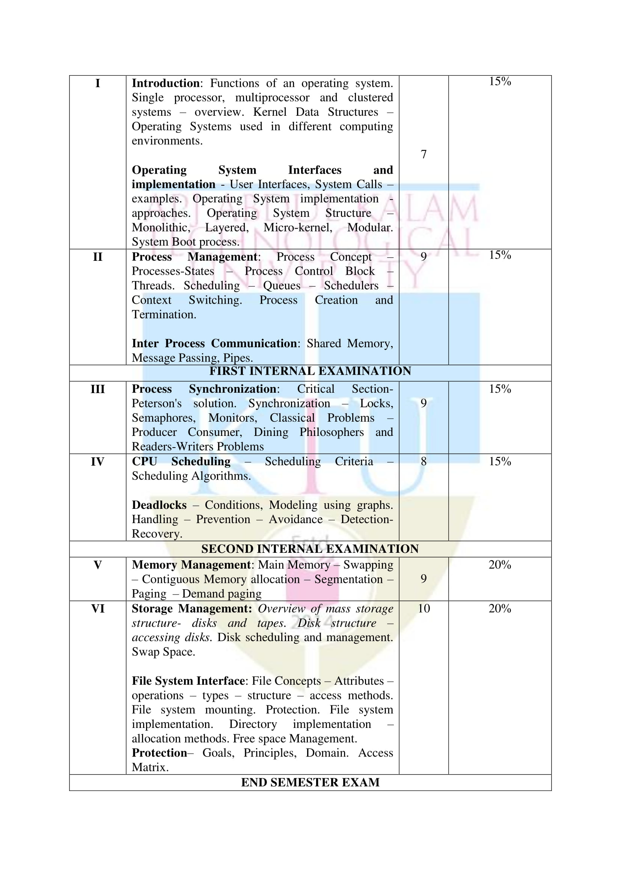

Slide 8
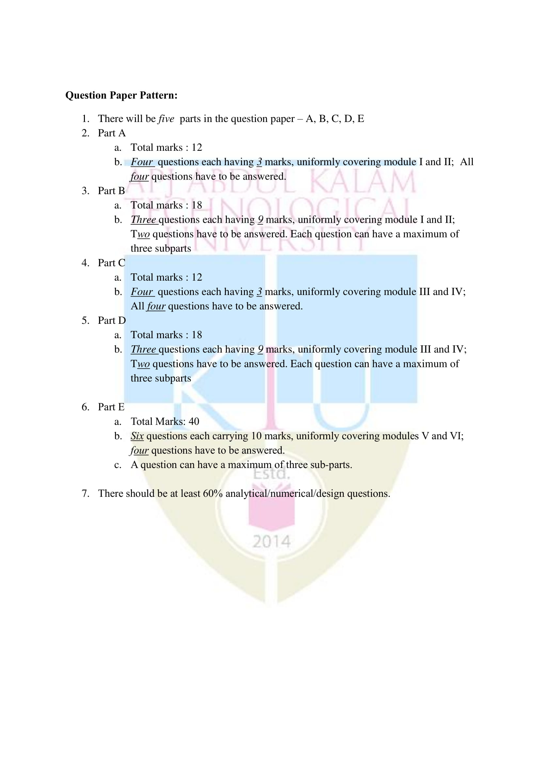

Slide 9
Course Outcomes
CO1 : Identify the significance of operating system in computing devices by understanding the purpose, structure and functions of operating system.
CO2 : Exemplify the communication between application programs and hardware devices through system calls.
CO3 : Identify several classical process-synchronization problems and tools that are used to solve these problems.
CO4 : Compare and illustrate various process scheduling algorithms.
CO5 : Apply appropriate memory and file management schemes.
CO6 : Illustrate various disk scheduling algorithms. Appreciate the need of access control and protection in an operating system.

Slide 10
MODULE I
Introduction: Functions of an operating system. Single processor, multiprocessor and clustered systems – overview. Kernel Data Structures – Operating Systems used in different computing environments.
Operating System Interfaces and implementation - User Interfaces, System Calls – examples. Operating System implementation - approaches. Operating System Structure – Monolithic, Layered, Micro- kernel, Modular. System Boot process.

Slide 11
Course Outcome
Identify the significance of operating system in computing devices by understanding the purpose, structure and functions of operating system.

Slide 12
Text Book:
Abraham Silberschatz, Peter B Galvin, Greg Gagne, Operating System Concepts, 9/e, Wiley India, 2015.
References:
1. Garry Nutt, Operating Systems: 3/e, Pearson Education, 2004
2. Bhatt P. C. P., An Introduction to Operating Systems: Concepts and Practice, 3/e, Prentice Hall of India, 2010.
3. William Stallings, Operating Systems: Internals and Design Principles, Pearson, Global Edition, 2015.
4. Andrew S Tanenbaum, Herbert Bos, Modern Operating Systems, Pearson, 4/e, 2015.
5. Madnick S. and J. Donovan, Operating Systems, McGraw Hill, 2001.
6. Hanson P. B., Operating System Principle, Prentice Hall of India, 2001.
7. Deitel H. M., An Introduction to Operating System Principles, Addison-Wesley, 1990.

Slide 13
What is an Operating System?
A program that acts as an intermediary between a user of a computer and the computer hardware
Operating system goals:
Execute user programs and make solving user problems easier
Make the computer system convenient to use
Use the computer hardware in an efficient manner

Slide 14
Computer System Structure
Computer system can be divided into four components:
Hardware
Provides basic computing resources. CPU, memory, I/O devices
Operating system
Controls and coordinates use of hardware among various applications and users
Application programs
Define the ways in which the system resources are used to solve the computing problems of the users. Eg Word processors, compilers, web browsers, database systems, video games
Users
People, machines, other computers

Slide 15

Components of a Computer System

Slide 16
The operating system controls the hardware and coordinates its use among the various application programs for the various users.
We can also view a computer system as consisting of hardware, software, and data.
The operating system provides the means for proper use of these resources in the operation of the computer system.
It provides an environment within which other programs can do useful work.
To understand more fully the operating system's role, we explore operating systems from two viewpoints:
  The user
  The system.

Slide 17
User View
Single user computers (e.g., PC, workstations). Such systems are designed for one user to monopolize its resources. The goal is to maximize the work that the user is performing. The operating system is designed mostly for ease of use and good performance.
Multi user computers (e.g., mainframes, computing servers). These users share resources and may exchange information. The operating system in such cases is designed to maximize resource utilization -- to assure that all available CPU time, memory, and I/O are used efficiently and that no individual users takes more than their air share.

Slide 18
Handheld computers (e.g., smartphones and tablets). The user interface for mobile computers generally features a touch screen. The systems are resource poor, optimized for usability and battery life.
Embedded computers (e.g., computers in home devices and automobiles) The user interface may have numeric keypads and may turn indicator lights on or off to show status. The operating systems are designed primarily to run without user intervention.

Slide 19
System View
Operating System as a resource allocator
  Manages all resources
  Decides between conflicting requests for efficient and fair resource use
Operating System as a control program
  Controls execution of programs to prevent errors and improper use of the computer

Slide 20
The operating system is the program running at all times on the computer -- usually called the kernel.
Along with the kernel, there are two other types of programs:
System programs, which are associated with the operating system but are not necessarily part of the kernel.
Application programs, which include all programs not associated with the operation of the system.

Slide 21
The emergence of mobile devices, have resulted in an increase in the number of features that constituting the operating system.
Mobile operating systems often include not only a core kernel but also middleware -- a set of software frameworks that provide additional services to application developers.
For example, each of the two most prominent mobile operating systems -- Apple's iOS and Google's Android -- feature a core kernel along with middleware that supports databases, multimedia, graphics etc.

Slide 22
Computer-System Organization
A general-purpose computer system consists of one or more CPUs and a number of device controllers connected through a common bus that provides access to shared memory.
Each device controller is in charge of a specific type of device (for example, disk drives, audio devices, or video displays).
Each device controller has a local buffer.
CPU moves data from/to main memory to/from local buffers.
The CPU and the device controllers can execute in parallel, competing for memory cycles. To ensure orderly access to the shared memory, a memory controller synchronizes access to the memory.

Slide 23
Computer Startup
Bootstrap program
Loaded at power-up or reboot Typically stored in ROM or EPROM, generally known as firmware.
Initializes all aspects of system
Loads operating system kernel and starts execution
Once the kernel is loaded and executing, it can start providing services to the system and its users.
Some services are provided outside of the kernel, by system programs that are loaded into memory at boot time to become system processes, or system daemons that run the entire time the kernel is running.
On UNIX, the first system process is init and it starts many other daemons. Once this phase is complete, the system is fully booted, and the system waits for some event to occur. The occurrence of an event is usually signaled by an interrupt.

Slide 24
Interrupts
There are two types of interrupts
Hardware -- a device may trigger an interrupt by sending a signal to the CPU, usually by way of the system bus.
Software -- a program may trigger an interrupt by executing a special operation called a system call.
A software-generated interrupt (sometimes called trap or exception) is caused either by an error (e.g., divide by zero) or a user request (e.g., an I/O request).
An operating system is interrupt driven.

Slide 25
Functions of Interrupts
When an interrupt occurs, the operating system preserves the state of the CPU by storing the registers and the program counter
Determines which type of interrupt has occurred and transfers control to the interrupt-service routine.
An interrupt-service routine is a collection of routines (modules), each of which is responsible for handling one particular interrupt.
The transfer is generally through the interrupt vector, which contains the addresses of all the service routines
Interrupt architecture must save the address of the interrupted instruction.

Slide 26
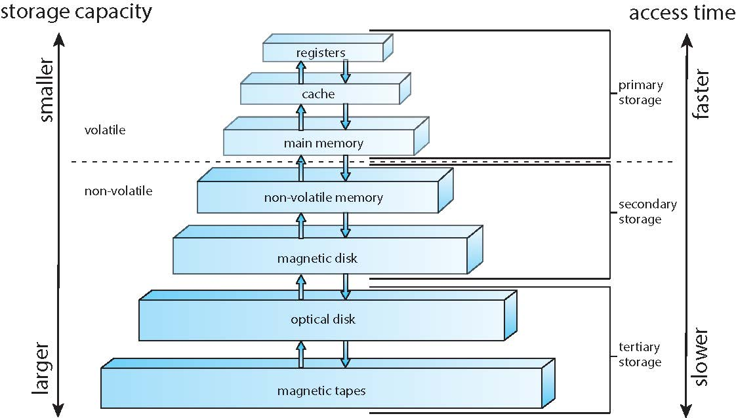
Storage-device hierarchy

Slide 27
I/O Structure
A general-purpose computer system consists of CPUs and multiple device controllers that are connected through a common bus.
Each device controller is in charge of a specific type of device. More than one device may be attached. For instance, seven or more devices can be attached to the small computer-systems interface (SCSI) controller.
A device controller maintains some local buffer storage and a set of special-purpose registers.
The device controller is responsible for moving the data between the peripheral devices that it controls and its local buffer storage.
Typically, operating systems have a device driver for each device controller. This device driver understands the device controller and provides the rest of the operating system with a uniform interface to the device.

Slide 28
To start an I/O operation, the device driver loads the appropriate registers within the device controller.
The device controller, in turn, examines the contents of these registers to determine what action to take (such as “read” a character from the keyboard).
The controller starts the transfer of data from the device to its local buffer. Once the transfer of data is complete, the device controller informs the device driver via an interrupt that it has finished its operation.
The device driver then returns control to the operating system, possibly returning the data or a pointer to the data if the operation was a read.
For other operations, the device driver returns status information.

Slide 29
Direct Memory Access Structure
Interrupt-driven I/O is fine for moving small amounts of data but can produce high overhead when used for bulk data movement such as disk I/O.
To solve this problem, direct memory access (DMA) is used.

Slide 30

How a Modern Computer Works
A Von Neumann architecture and a depiction of the interplay of all components of a computer system.

Slide 31
Computer-System Architecture
Single general-purpose processor
Most systems have special-purpose processors as well
Multiprocessors systems -Also known as parallel systems, tightly-coupled systems
  Symmetric Multiprocessing – each processor performs all tasks
  Asymmetric Multiprocessing – each processor is assigned a specific task
Multicore systems. Multiple computing cores on a single chip.
  Multicore systems can be more efficient than multiple chips with single cores because:
    On-chip communication is faster than between-chip communication.
    One chip with multiple cores uses significantly less power than multiple single-core chips.
Note -- while multicore systems are multiprocessor systems, not all multiprocessor systems are multicore.

Slide 32
Computer-System Architecture (Contd..)
Clustered Systems
Like multiprocessor systems, but multiple systems working together
Usually sharing storage via a storage-area network (SAN)
  Asymmetric clustering has one machine in hot-standby mode
  Symmetric clustering has multiple nodes running applications, monitoring each other
Some clusters are for high-performance computing (HPC). Applications must be written to use parallelization

Slide 33
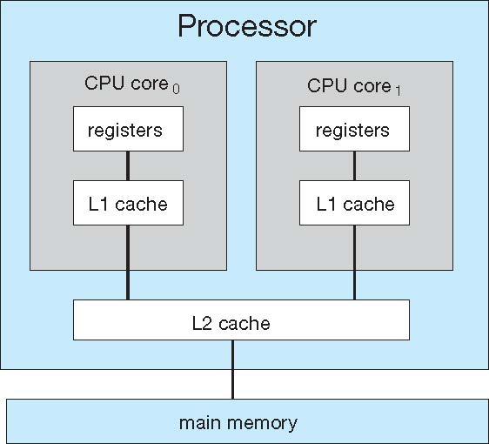
A dual-core with two cores placed on the same chip

Slide 34
Modes of Operation
A mechanism that allows the OS to protect itself and other system components
Two modes:
  User mode
  Kernel mode
Mode bit (0 or 1) provided by hardware
Provides ability to distinguish when system is running user code or kernel code
Some instructions designated as privileged, only executable in kernel mode
Systems call by a user asking the OS to perform some function changes from user mode to kernel mode.
Return from a system call resets the mode to user mode.

Slide 35

Transition from User to Kernel Mode

Slide 36
Process Management
A process is a program in execution. It is a unit of work within the system. Program is a passive entity, process is an active entity.
  Process needs resources to accomplish its task
      CPU, memory, I/O, files, etc.
      Initialization data
  Process termination requires reclaim of any reusable resources
A thread is a basic unit of CPU utilization within a process.
Single-threaded process. Instructions are executed sequentially, one at a time, until completion
Process has one program counter specifying location of next instruction to execute
Multi-threaded process has one program counter per thread

Slide 37
Process Management Activities
The operating system is responsible for the following activities in connection with process management:
  Creating and deleting both user and system processes
  Suspending and resuming processes
  Providing mechanisms for process synchronization
  Providing mechanisms for process communication
  Providing mechanisms for deadlock handling

Slide 38
Memory Management
To execute a program all (or part) of the instructions must be in memory
All (or part) of the data that is needed by the program must be in memory.
Memory management determines what is in memory and when
Memory management activities
  Keeping track of which parts of memory are currently being used and by whom
  Deciding which processes (or parts thereof) and data to move into and out of memory
  Allocating and deallocating memory space as needed

Slide 39
File System Management
Files usually organized into directories
Access control on most systems to determine who can access what
OS activities include
  Creating and deleting files and directories
  Primitives to manipulate files and directories
  Mapping files onto secondary storage
  Backup files onto stable (non-volatile) storage media

Slide 40
Kernel Data Structures
Array is a simple data structure in which each element can be accessed directly. For example, main memory is constructed as an array.
Linked lists accommodate items of varying sizes and allow easy insertion and deletion of items. Disadvantage of using a list is that performance for retrieving a specified item in a list of size n is linear.
Stack used when invoking function calls.
Queue for organizing tasks that are waiting to be run on an available CPU.
Tree Linux uses a balanced binary search tree as part its CPU -scheduling algorithm
Hash function is applied to the user name, which is then used to retrieve the password and used for authentication.
Bitmap is a string of n binary digits that can be used to represent the status of resource availability. 0 means that the resource is available, while 1 indicates that it is unavailable (or vice-versa).
Linux data structures defined in include files <linux/list.h>, <linux/kfifo.h>, <linux/rbtree.h>

Slide 41
Computing Environments - Traditional
Stand-alone general purpose machines

Slide 42
Computing Environments - Mobile
Handheld smartphones, tablets, etc
What is the functional difference between them and a “traditional” laptop?
Extra features – more OS features (GPS )
Allows new types of apps like augmented reality
Use IEEE 802.11 wireless, or cellular data networks for connectivity
Leaders are Apple iOS and Google Android

Slide 43
Computing Environments – Distributed
Collection of separate, possibly heterogeneous, systems networked together
Network is a communications path, TCP/IP most common
Local Area Network (LAN)
Wide Area Network (WAN)
Metropolitan Area Network (MAN)
Personal Area Network (PAN)
Network Operating System provides features to allow sharing of data between systems across a network.
Communication scheme allows systems to exchange messages
Illusion of a single system

Slide 44

Computing Environments – Client-Server
Dumb terminals supplanted by smart PCs
Many systems now servers, responding to requests generated by clients
Compute-server system provides an interface to client to request services (i.e., database)
File-server system provides interface for clients to store and retrieve files

Slide 45

Computing Environments - Peer-to-Peer
Another model of distributed system. P2P does not distinguish clients and servers
Instead all nodes are considered peers
Each node may act as client, server, or both
Node must join P2P network
Registers its service with central lookup service on network, or
Broadcast request for service and respond to requests for service via discovery protocol
Examples include Napster and Gnutella, Voice over IP (VoIP) such as Skype

Slide 46
Computing Environments – Cloud Computing
Delivers computing, storage, even apps as a service across a network
Logical extension of virtualization because it uses virtualization as the base for it functionality.
Amazon EC2 has thousands of servers, millions of virtual machines, petabytes of storage available across the Internet, pay based on usage
Many types
Public cloud – available via Internet to anyone willing to pay
Private cloud – run by a company for the company’s own use
Hybrid cloud – includes both public and private cloud components
Software as a Service (SaaS) – one or more applications available via the Internet (i.e., word processor)
Platform as a Service (PaaS) – software stack ready for application use via the Internet (i.e., a database server)
Infrastructure as a Service (IaaS) – servers or storage available over Internet (i.e., storage available for backup use)

Slide 47

Cloud computing environments composed of traditional OSes, plus VMMs, plus cloud management tools
Internet connectivity requires security like firewalls
Load balancers spread traffic across multiple applications

Slide 48
Computing Environments – Real-Time Systems
Real-time embedded systems most prevalent form of computers
  Vary considerable, special purpose, limited purpose OS, real-time OS
  Use expanding
Many other special computing environments as well
  Some have OSes, some perform tasks without an OS
Real-time OS has well-defined fixed time constraints
  Processing must be done within constraint
  Correct operation only if constraints met

